Slide 1

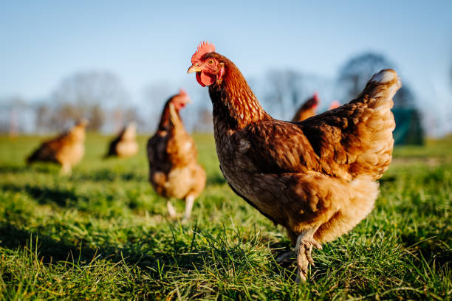

Poultry HUB
SMART Poultry Farm in Sri Lanka Using IoT
2022 – 23_J35
PP1

Slide 2

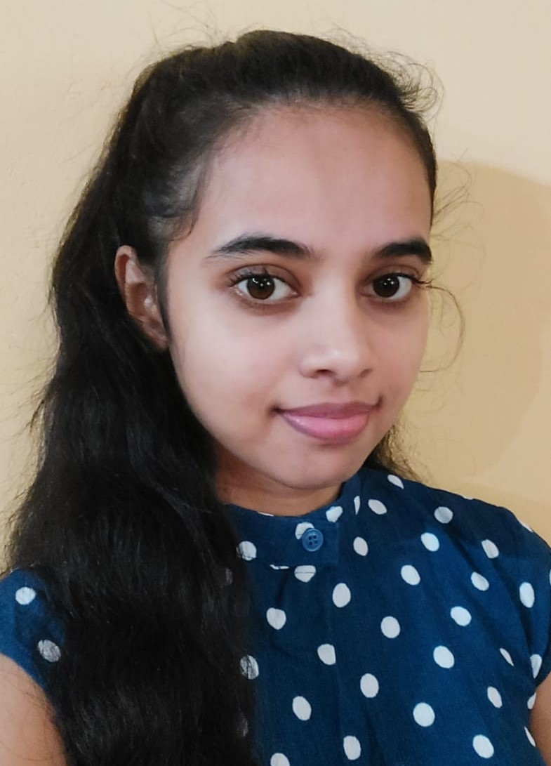

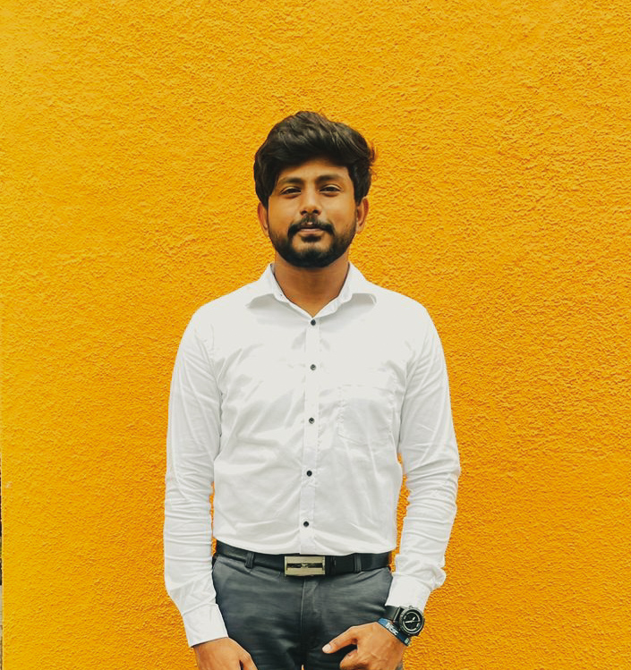



Meet Our Team
Mr. Kanishka Yapa
Supervisor
Ms.Pipuni Wijesirii
Co-Supervisor
Madushan M.A.C
IT19960128
B.M.W.S.WIJESEKARA IT19958248
A.M.S.C.ANANDA
IT19958484
W.A.L.H.P.K.Perera IT19953434
Project Id: 22_23-J35

Slide 3
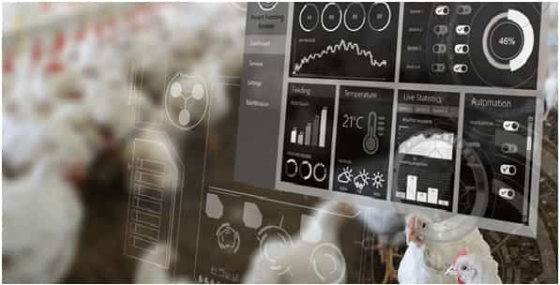


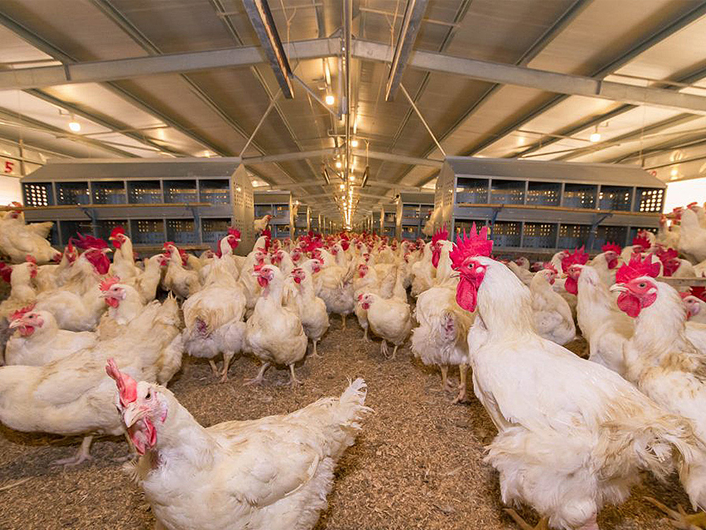
INTRODUCTION
Smart agricultural solutions with the SMART Poultry farms are very important to keep safe and collect information for accounting purpose that supports to take decisions.
The common poultry farm is spread all over the world and there are very difficult times and threats. Now it has increased the cost and is a threat to the healthy life of the people. Automatic poultry farms have failed in some cases due to the lack of knowledge to operate them.
Even though there are automatic features in the automatic chicken farm as it is now, it is very important to inform the owner of the farm because it is a very important to keep eye on it.
And as we have analyzed how many automatic chicken farms we see, this kind of feature deficiency affects an automatic chicken farm tremendously.
This special features provides a very useful service for a farm.
01

Slide 4

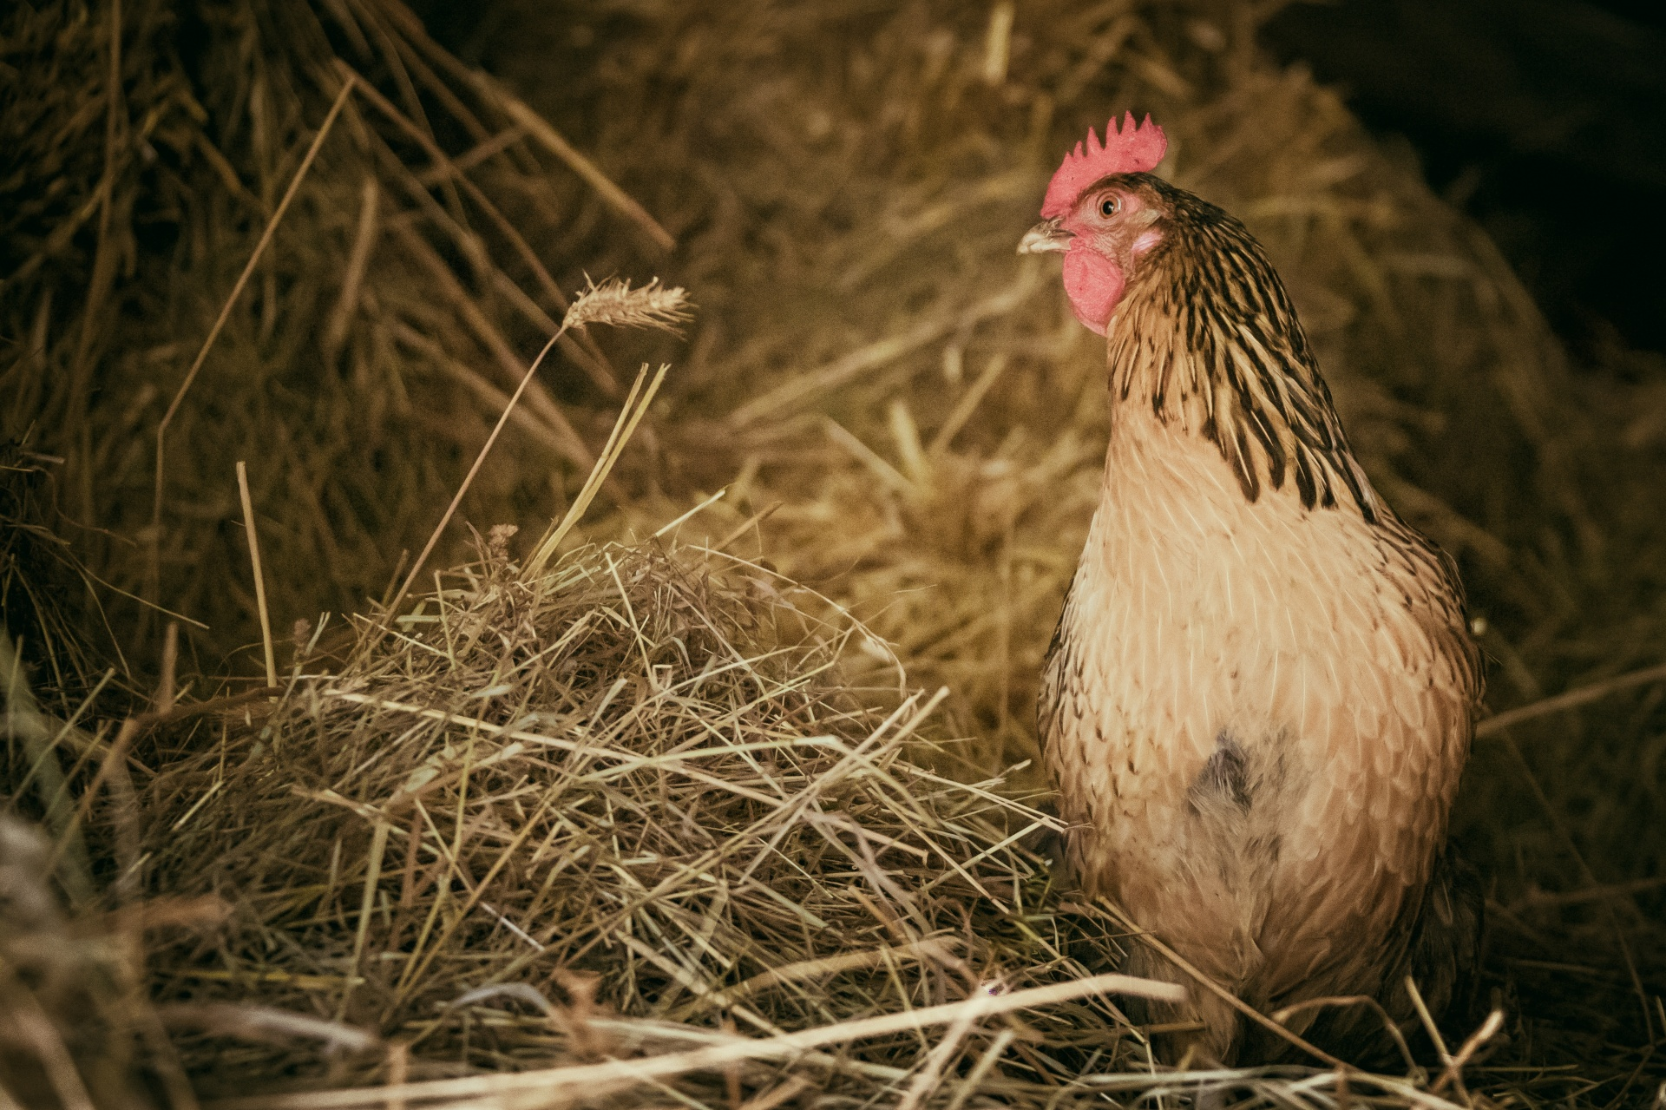


Research Questions
Day by day many farms face huge financial problems, Also, poultry farm owners can see this as a common problem, but considering the current prices, a high price has been set according to the market demand, but we need to balance it by using new technologies.
Poultry farms are the main source of income for several people in Sri Lanka.
Unwanted people and predators enter the farm causing damage to the farm. Therefore, there is a problem of farm and animal safety.
There is a problem with monitoring the overall condition of the farm from the outside.
Reduce costs by handover human works to machine
According to Market demand farmers must increase their production
02

Slide 5
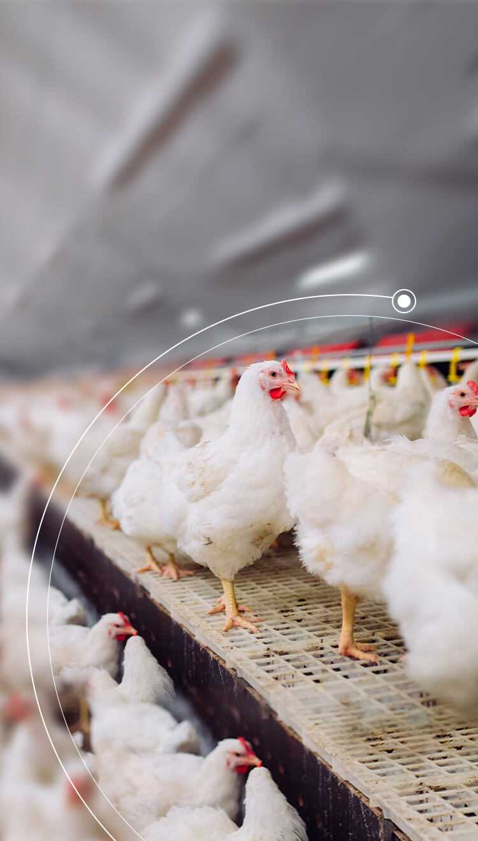
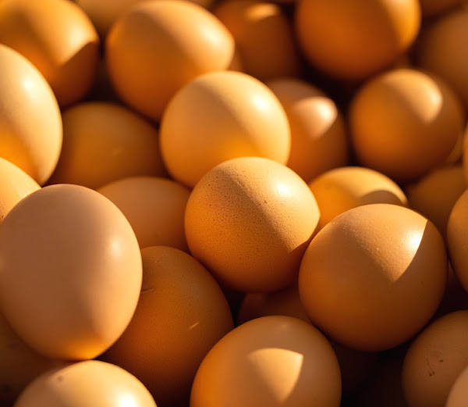
Main Objective
Increasing production by providing an automatic solution to the poultry farm as a solution to the existing difficulties.
Sub Objective
01
02
03
04
Unauthorized animal Identification by image processing and prevent them to come inside
Developing a System to predict the product outcome and control conditions in the poultry farm to increase productivity by designing a new algorithm, and it’s going to be used to get most accurate Date
The primary objective to introduce the automated and accurate product for enhance the egg productivity and reduce the waste cost by helping to the farm owner daily task.
To determine smart door lock in a hybrid approach for a low cost.
03

Slide 6
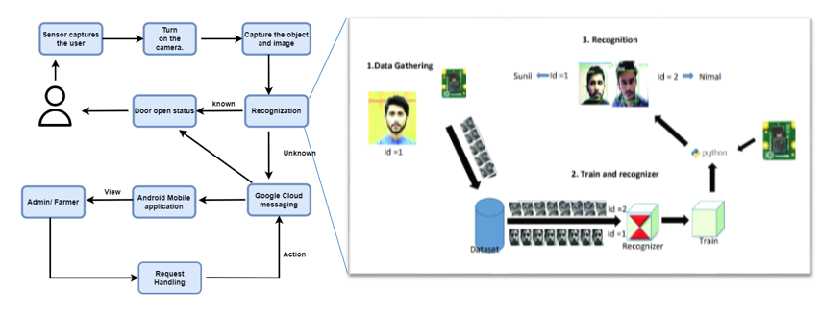



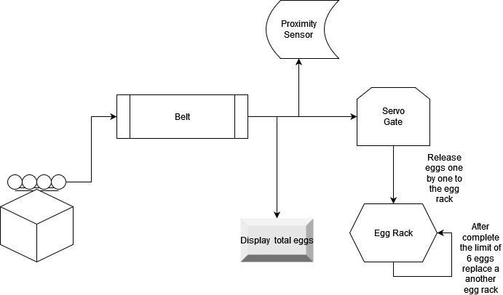
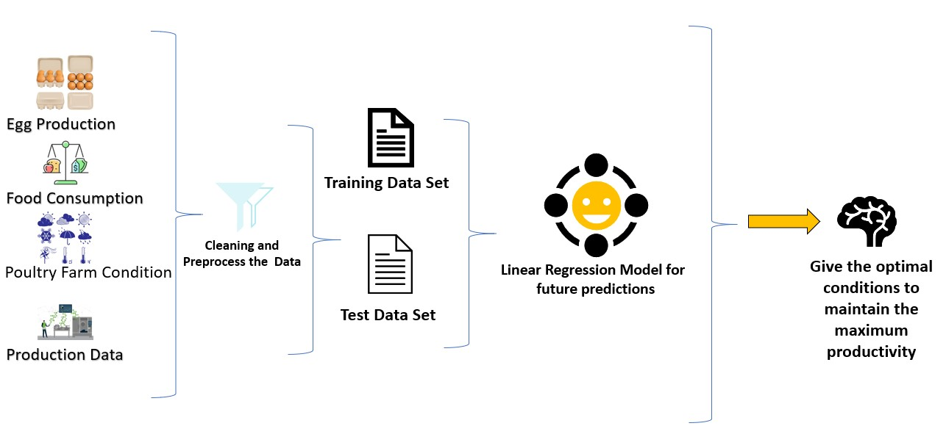
System Diagram
Pre -processing
By-Model Fusion
Image input
Feature extraction
Trapped Images
Classification
Video input
Unauthorized animal
authorized animal
Warning System
Exit
Ultrasonic device turn on prevent them according to detected animal
04

Slide 7
MADUSHAN M.A.C
IT19960128
SPECIALIZATION - INFORMATION TECHNOLOGY
IT19960128| Madushan M.A.C
| Project Id: 22_23-J 35
05

Slide 8

Research Question
Poultry farm products are becoming more in demand.
Inability to detect the safety of the chicks in time.
Security of poultry farm is important.
It is also useful to have smart prevention techniques for other important things to ensure chicken safety.
IT19960128| Madushan M.A.C
| Project Id: 22_23-J 35
08

Slide 9
Research Gap
Features | Research(A) | Research(B) | Research(C) | Research(D) | Research(E) | Research(F) | Our Expected System
By model Fusion
Object detection
Accuracy level
Object detection and prevention With the automatic barrier
Human and animal Detection
Smooth operations in low light Situation
IT19960128| Madushan M.A.C
| Project Id: 22_23-J 35
07

Slide 10
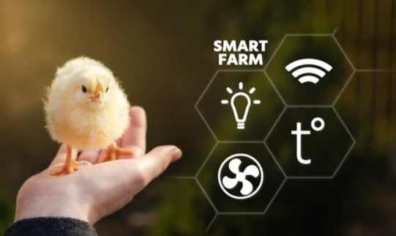
Novelty
“By model Fusion”: this is combination of Static image processing and Video processing to get most Accuracy level.
Why do we need to use this. sometimes animals not going to movement stage. So here we are going to identify using hybrid technology
IT19960128| Madushan M.A.C
| Project Id: 22_23-J 35
06

Slide 11
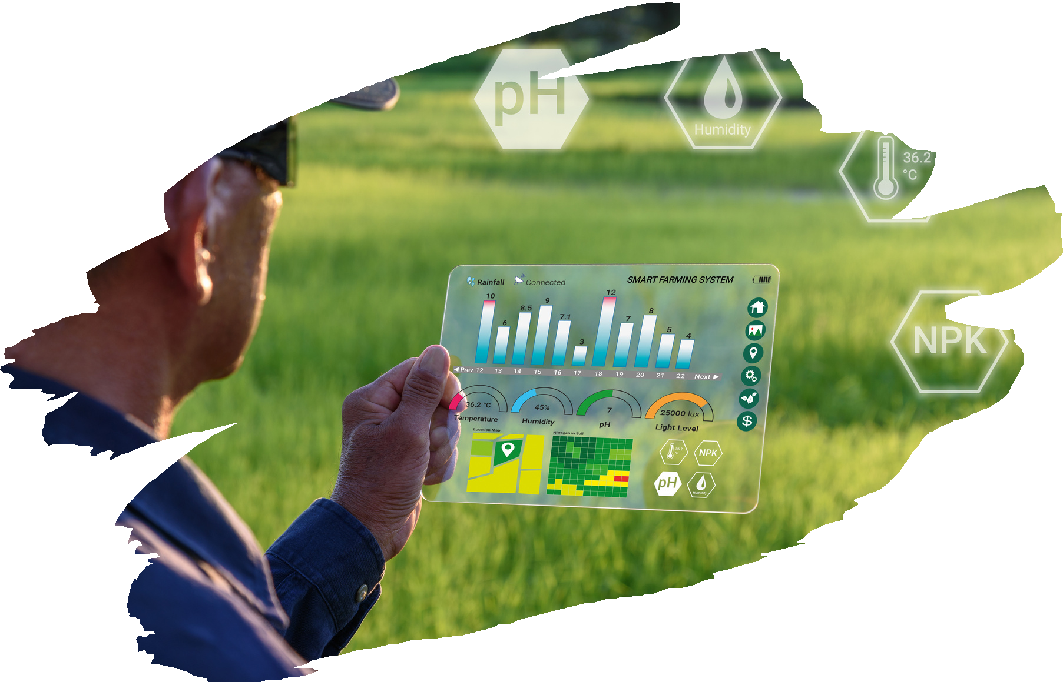
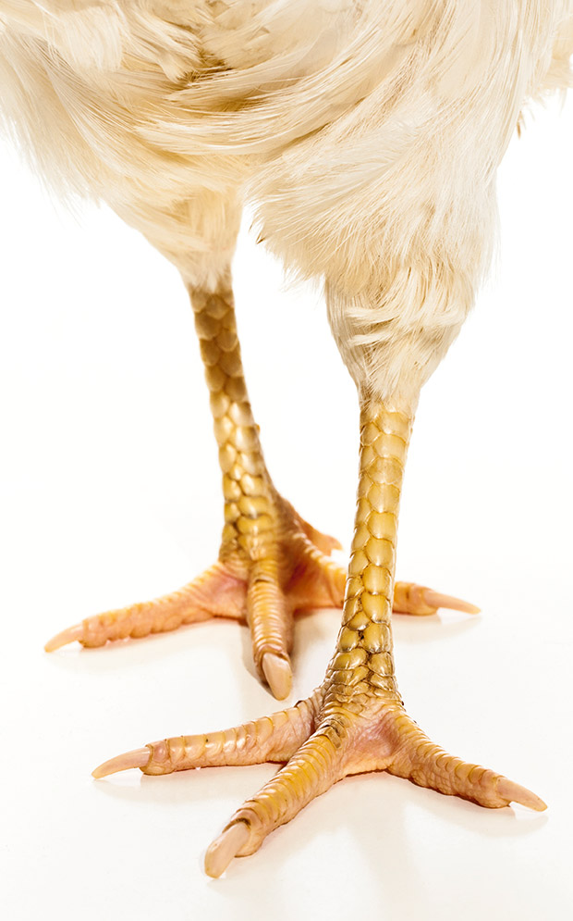

Main Objective
According to dataset, this system will identify the unauthorized animal by comparing the result .
Furthermore, our system will prevent them to come inside by ultrasonic device.
Sub Objective
01
02
03
04
Identify Unauthorized animals with model fusion .
Preprocess the captured images most Accurately .
Determine captured images is authorized or unauthorized.
Prevent them to come inside to the farm using spared Ultrasonic sound
09
IT19960128| Madushan M.A.C
| Project Id: 22_23-J 35

Slide 12
Methodology
The entire image should be detected by image processing and the Animals should be identified and Prevent them.
If there is any unauthorized animal must prevent by using Ultrasonic Device
Background should be cover by 4 Cameras
IT19193182 | H A R Manoramya
| Project Id: 22_23-J 57

Slide 13
System Diagram
Pre -processing
By-Model Fusion
Image input
Feature extraction
Trapped Images
Classification
Video input
Unauthorized animal
authorized animal
Warning System
Exit
Ultrasonic device turn on prevent them according to detected animal
IT19960128| Madushan M.A.C
| Project Id: 22_23-J 35

Slide 14

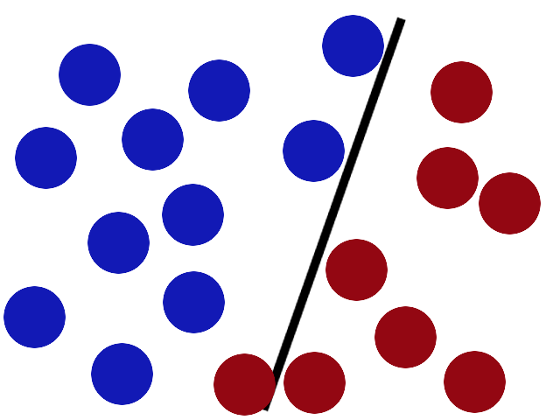



Technologies, Tools and Algorithms
Algorithm: Support vector machine(SVM)
Develop Mobile application: Flutter
Model Trainer : Colab
Languages : Python,Dart
IT19960128| Madushan M.A.C
| Project Id: 22_23-J 35

Slide 15
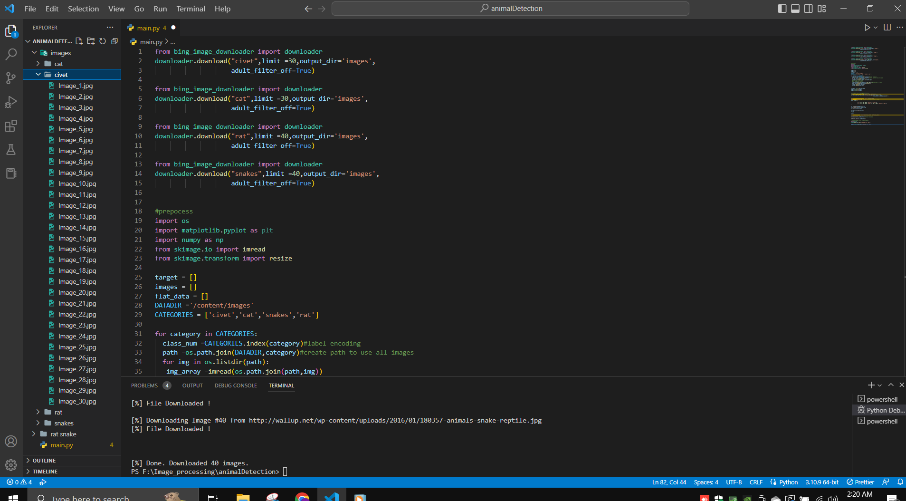
Completion of the Project
IT19960128| Madushan M.A.C
| Project Id: 22_23-J 35
16

Slide 16
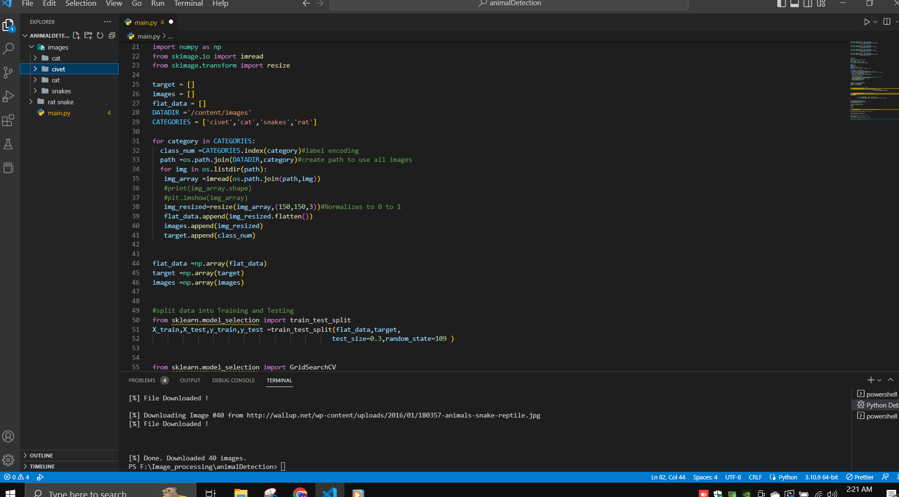
Completion of the Project
IT19960128| Madushan M.A.C
| Project Id: 22_23-J 35
13

Slide 17
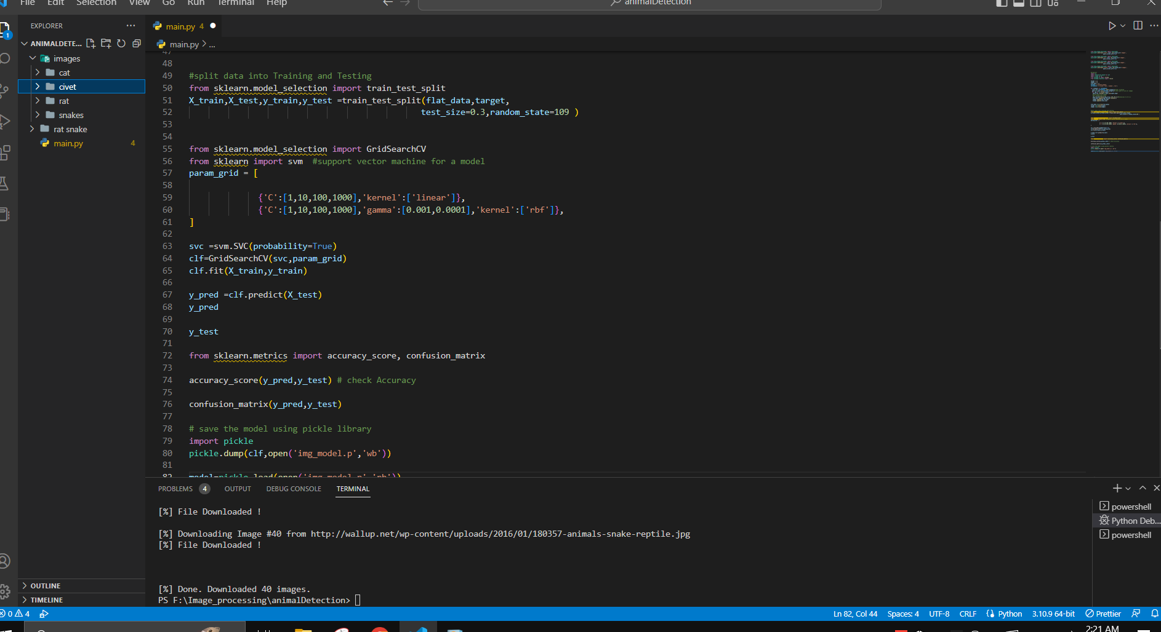
Completion of the Project
IT19960128| Madushan M.A.C
| Project Id: 22_23-J 35
14

Slide 18
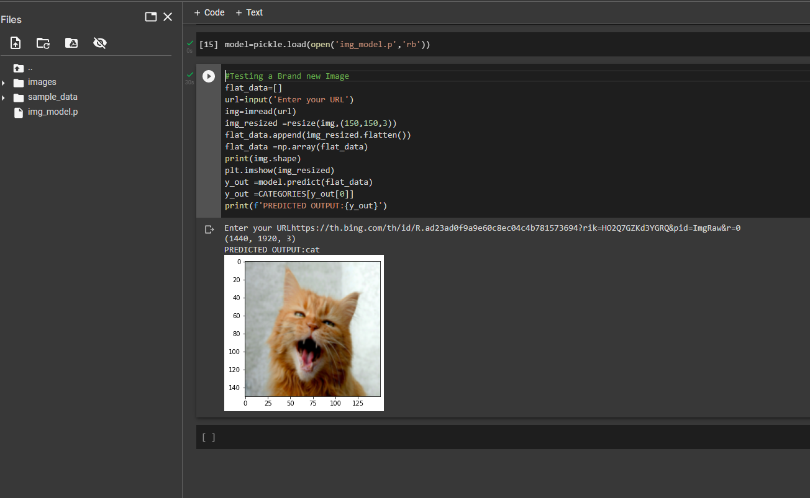
Completion of the Project
IT19960128| Madushan M.A.C
| Project Id: 22_23-J 35
15

Slide 19

Achievements
Collected Unauthorized animal data set by web Scrapping
Unauthorized animal identification
Achieved 50% Accuracy level object identification
IT19960128| Madushan M.A.C
| Project Id: 22_23-J 35
17

Slide 20
What's to be done
Implement Ultrasonic Device to spared out for prevent Unnotarized animals
Complete a user-friendly Mobile application get output relevant data and information.
Testing the finalized application and the device in the real-time environment.
Improve the accuracy
IT19960128| Madushan M.A.C
| Project Id: 22_23-J 35
18

Slide 21
B.M.W.S.Wijesekara IT19958248
SPECIALIZATION - INFORMATION TECHNOLOGY
IT19958248 | BMWS WIJESEKARA
| Project Id: 22_23_j35
05

Slide 22
Newalty
“Egg Vision”: A machine learning based predictive and early warning system for maximizing egg production.
Why do we use the word ”Egg Vision”,our system provides a clear and accurate view of egg production.
I forcesing on how to maximize the egg production by maintaining the proper condition.
If egg production continuesly at low level,A warninig is also given about the conditions to be maintained.
IT19958248 | BMWS WIJESEKARA
| Project Id: 22_23_j35
06

Slide 23

Research Questions
How to Know about the increase or decrease in production compared to the previous Year?​
How to know about the increase or decrease in production according to the condition in the Poultry farm?​
IT19958248 | BMWS WIJESEKARA
| Project Id: 22_23_j35
08

Slide 24
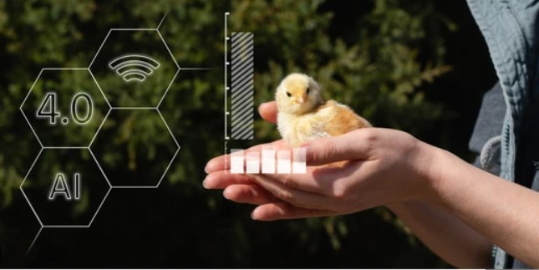
Main Objective
Developing a System to predict the product outcome and control conditions in the poultry farm to increase productivity by designing a new algorithm, and it’s going to be used to get most accurate Date
Sub Objective
01
02
03
Showing whether the production is productive or non productive compared to the previous months.​
analyze the past 5 to 10 years 'and show how to maximize the egg production by maintaining the proper conditions
Pointing out solutions and actions to be taken on production decreases and increases.​
IT19958248 | BMWS WIJESEKARA
| Project Id: 22_23_j35
09

Slide 25
Research Gap
Features | Research(A) | Research(B) | Research(C) | Research(D) | Research(E) | Research(F) | Our Expected System
Analyzing The Feed Type
Analyze the Humidity
Analyze the Temperature
Analyze the Light Intensity
Gathering data from our implemented system
Analyse the egg production data and show how maximize the egg production by maintaining the proper conditions.
IT19958248 | BMWS WIJESEKARA
07

Slide 26

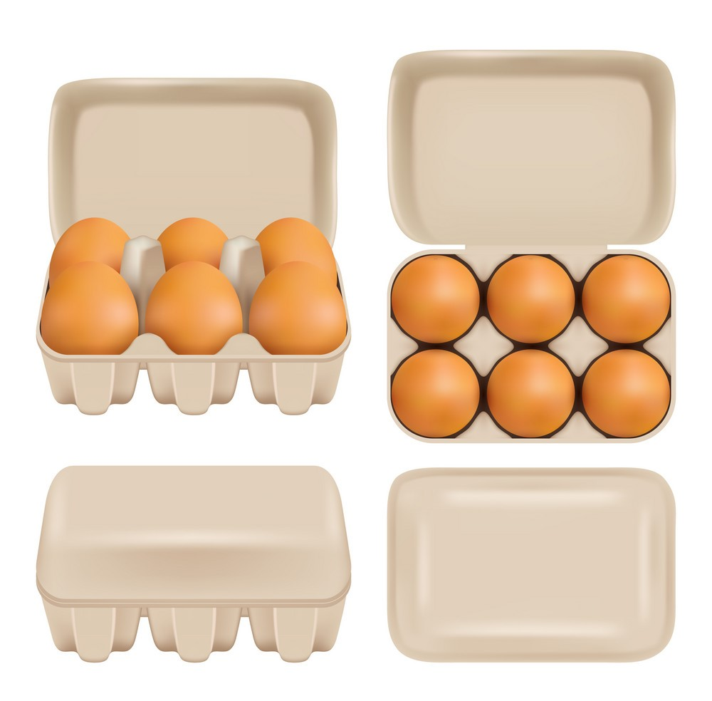









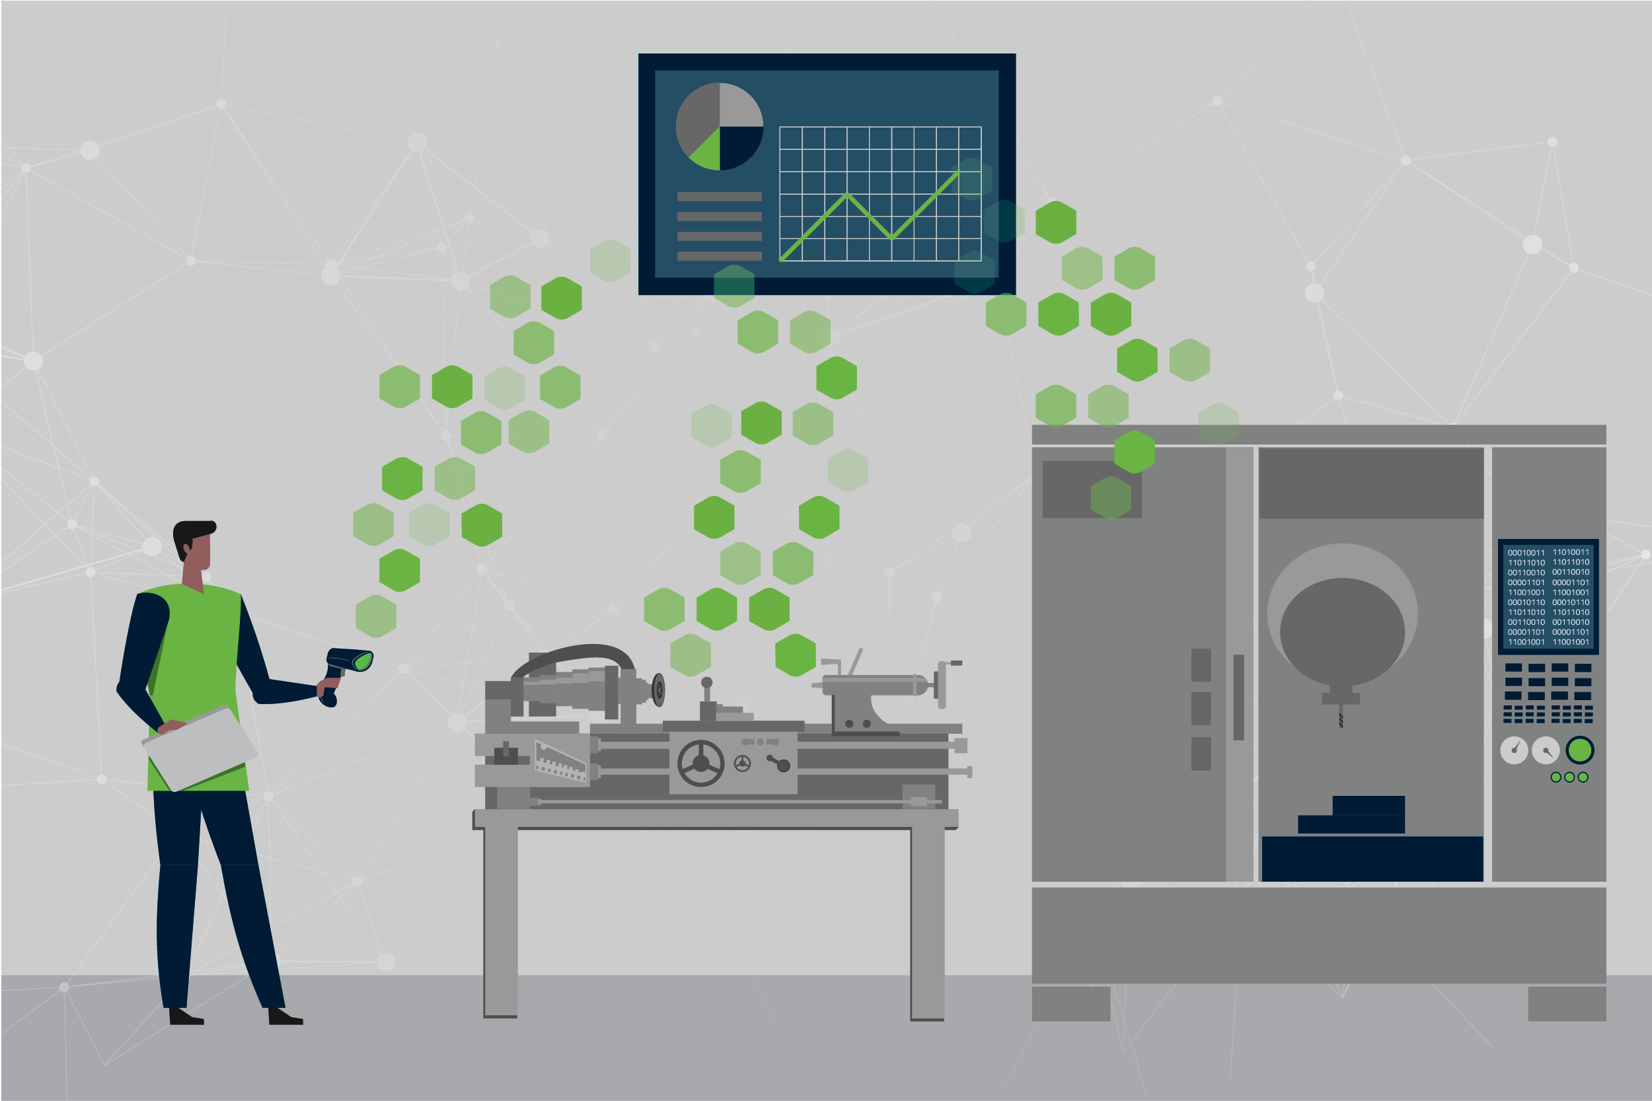
Implementation of the model
System Diagram
Egg Production
Training Data Set
Food Consumption
Cleaning and Preprocess the Data
Poultry Farm Condition
Linear Regression Model for
future predictions
Give the optimal conditions to maintain the maximum productivity
Test Data Set
Production Data
IT19958248 | BMWS WIJESEKARA
| Project Id: 22_23_j35

Slide 27

Methodology
Under methodology, we are going talk in detail about,
​
Data Collecting Methodologies ​
Features and Features Selection Methodologies​
Model Implementation & Technologies
Final outcome of the sub-objective ​
IT19958248 | BMWS WIJESEKARA

Slide 28
Technologies, Tools and Algorithms
Algorithm: Desicion tree classifier Model training: colab
Machine learning
Develop web application: Flutter
Languages: python , Dart
IT19958248 | BMWS WIJESEKARA

Slide 29
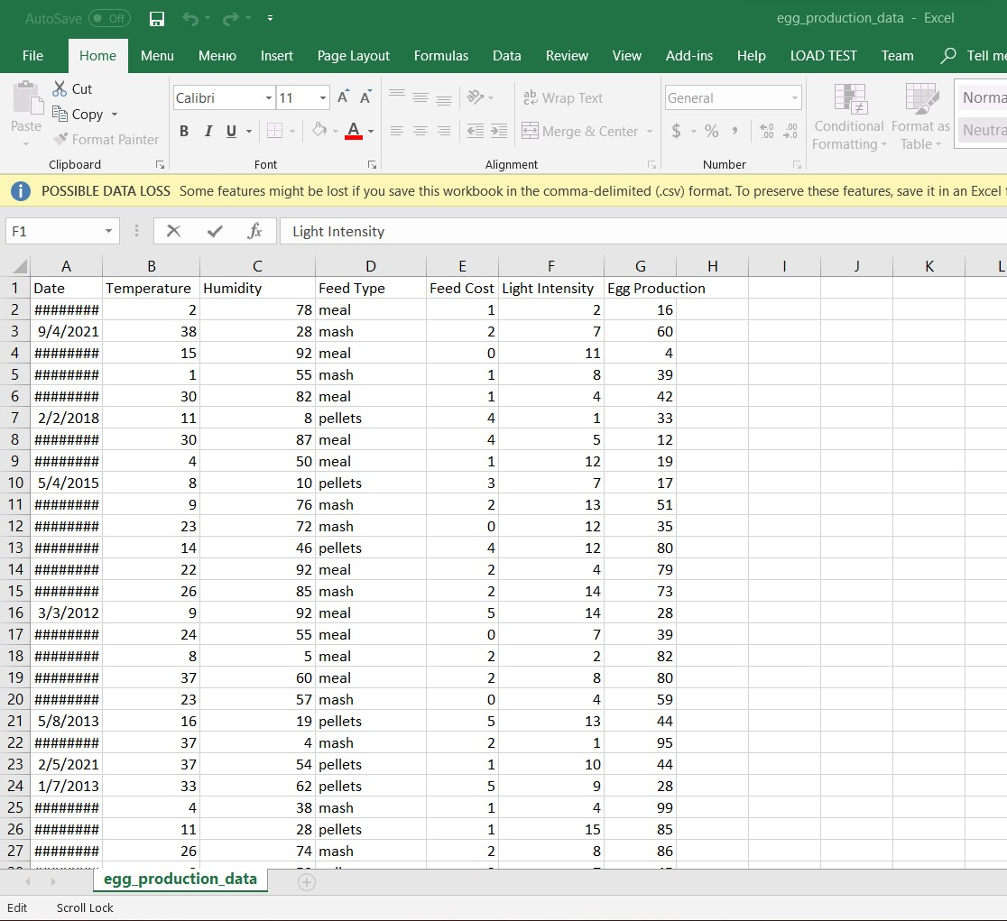
Completion of the Project
IT19958248 | BMWS WIJESEKARA

Slide 30
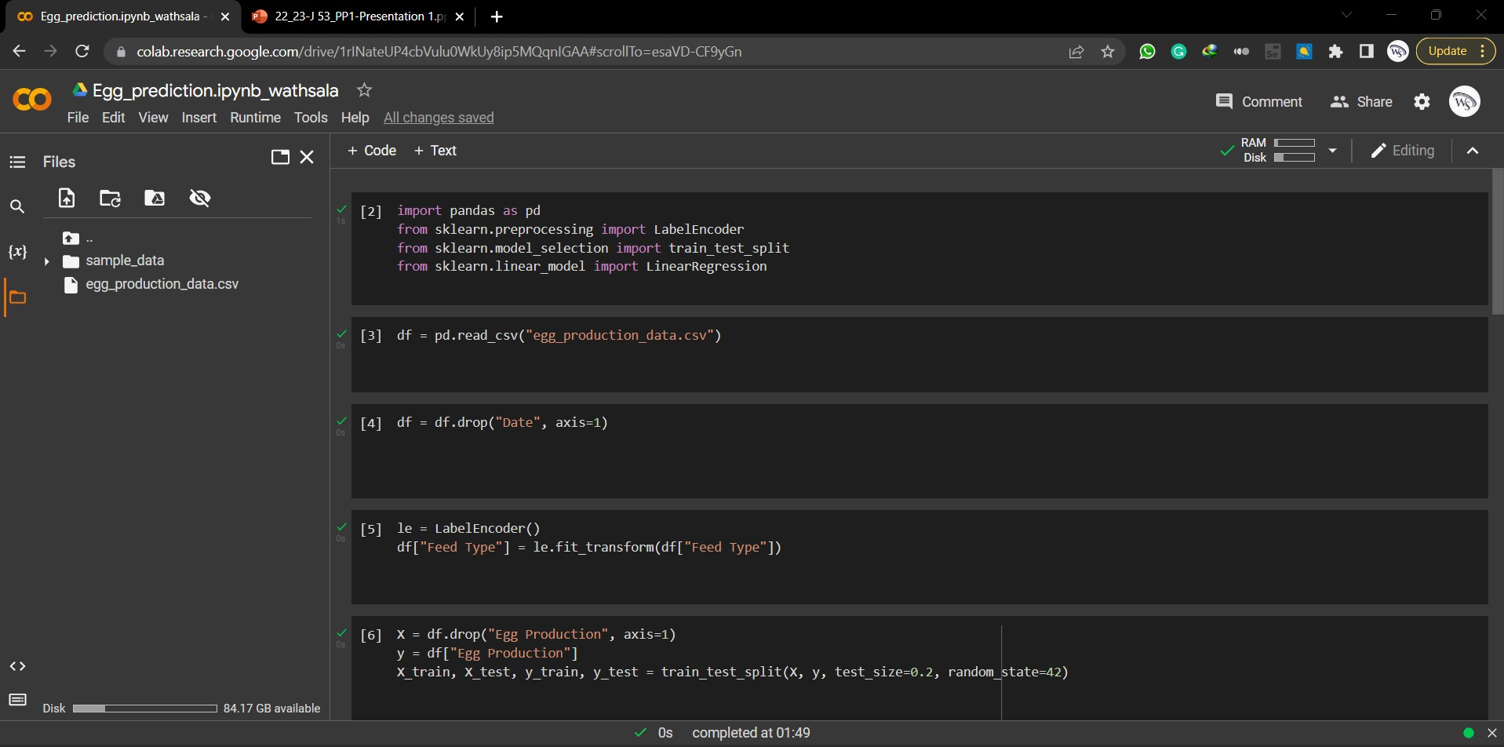
Completion of the Project
IT19958248 | BMWS WIJESEKARA

Slide 31
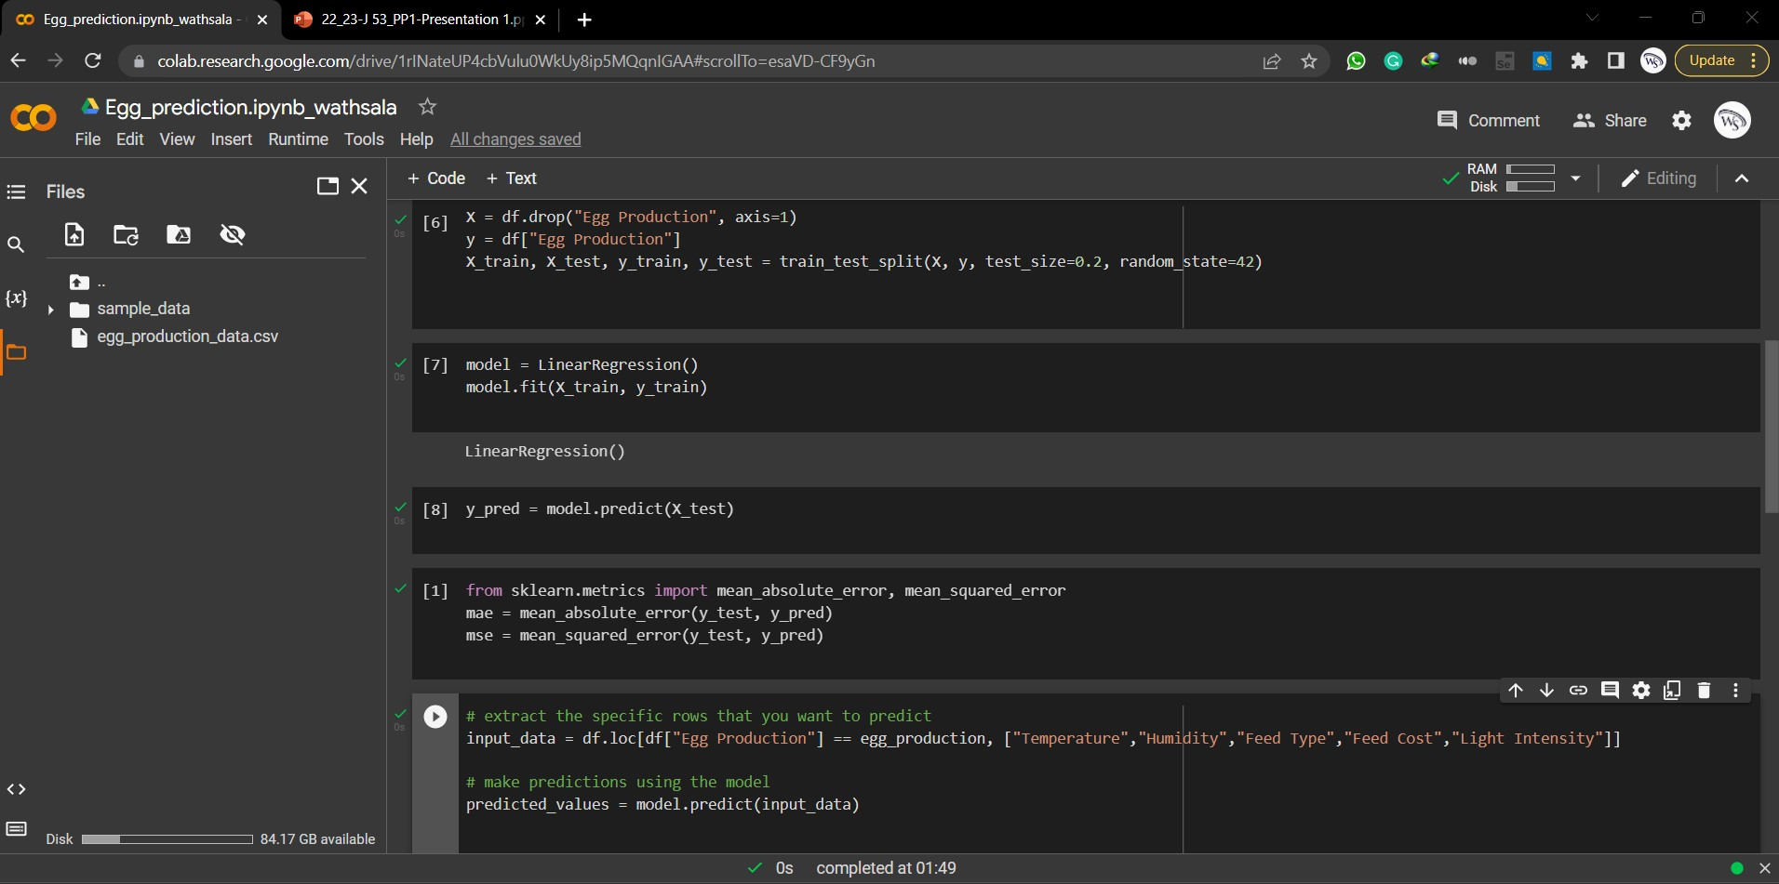
Completion of the Project
IT19958552 | SMRM Senanayake

Slide 32
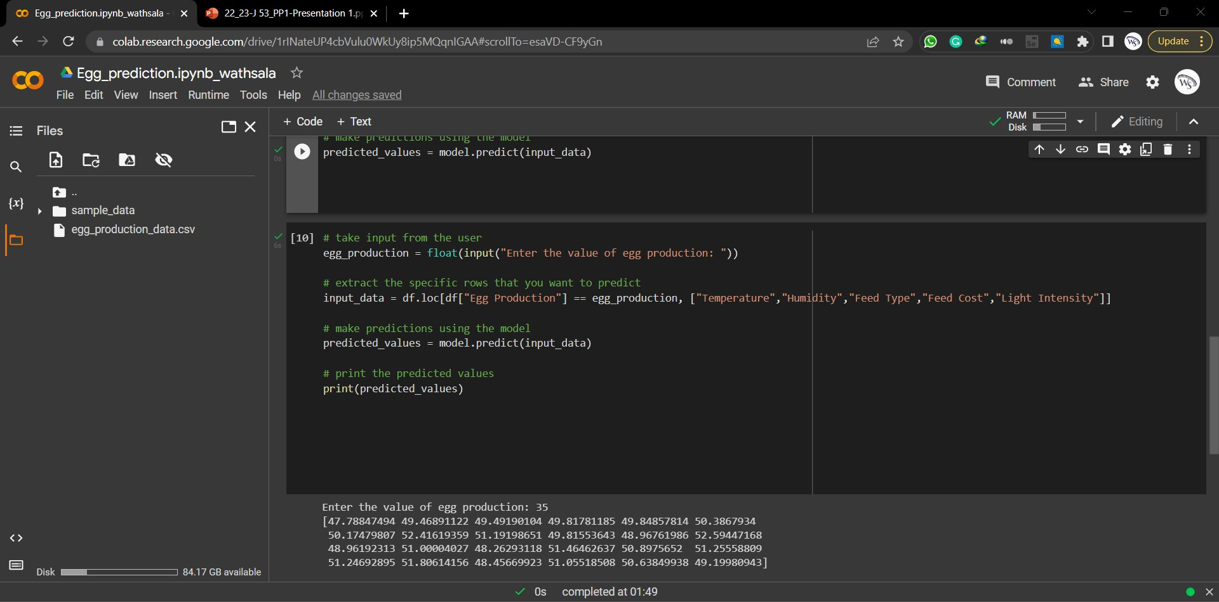
Completion of the Project
IT19958248 | BMWS WIJESEKARA

Slide 33

Achivements
Prepare datasets
Checking the accuracy of the model using data set
Giving prediction about the condition that should be maintained to produce how many eggs.
IT19958248 | BMWS WIJESEKARA

Slide 34

What's to be done
Increasing the accuracy by using more algorithms and using the most optimal algoritham.
The information obtained from the sensors is update live to our app.
In case of a decrease in production,the necessary control conditions
To increase the production are updated through the app.
IT19958248 | BMWS WIJESEKARA

Slide 35
A.M.S.C Ananda IT19958484
SPECIALIZATION - INFORMATION TECHNOLOGY
IT19958484 | AMSC Ananda
| Project Id: 22_23-J 35
05

Slide 36


Research Question
Environmental impact of egg collection systems and egg production
​
Health and safety implications for workers using egg collection systems​
IT19958484 | AMSC Ananda
| Project Id: 22_23-J 35
08

Slide 37
Main Objective
The primary objective to introduce the automated and accurate product for enhance the egg productivity and reduce the waste cost by helping to the farm owner daily task.
Sub Objective
01
02
03
Eggs are safely moved to the collection bin and securely packing
Displaying the information about the amount of eggs collected
to the farm owner through the mobile App.
The mobile application facilitates the farm owner to control the egg collection process.
IT19958484 | AMSC Ananda
| Project Id: 22_23-J 35
09

Slide 38
Research Gap
Features | Research(A) | Research(B) | Research(C) | Research(D) | Research(E) | Research(F) | Our Expected System
Safety Of Egg
Farmer can control
Egg are not dirty
Mobile-based identiﬁcation approach
IT19958484 | AMSC Ananda
07

Slide 39
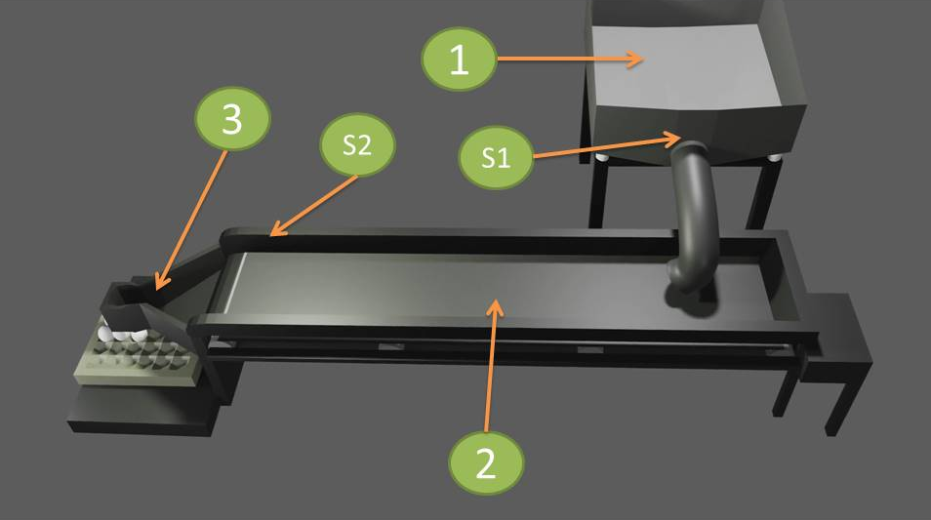

Overall device and 3D model
IT19958484 | AMSC Ananda
| Project Id: 22_23-J 35

Slide 40
System Diagram
IT19958484 | AMSC Ananda
| Project Id: 22_23-J 35

Slide 41

Technologies, Tools and Algorithms
IDE – Arduino IDE
Develop web application:Flutter
Languages: C Language
IT19958484 | AMSC Ananda
| Project Id: 22_23-J 35

Slide 42
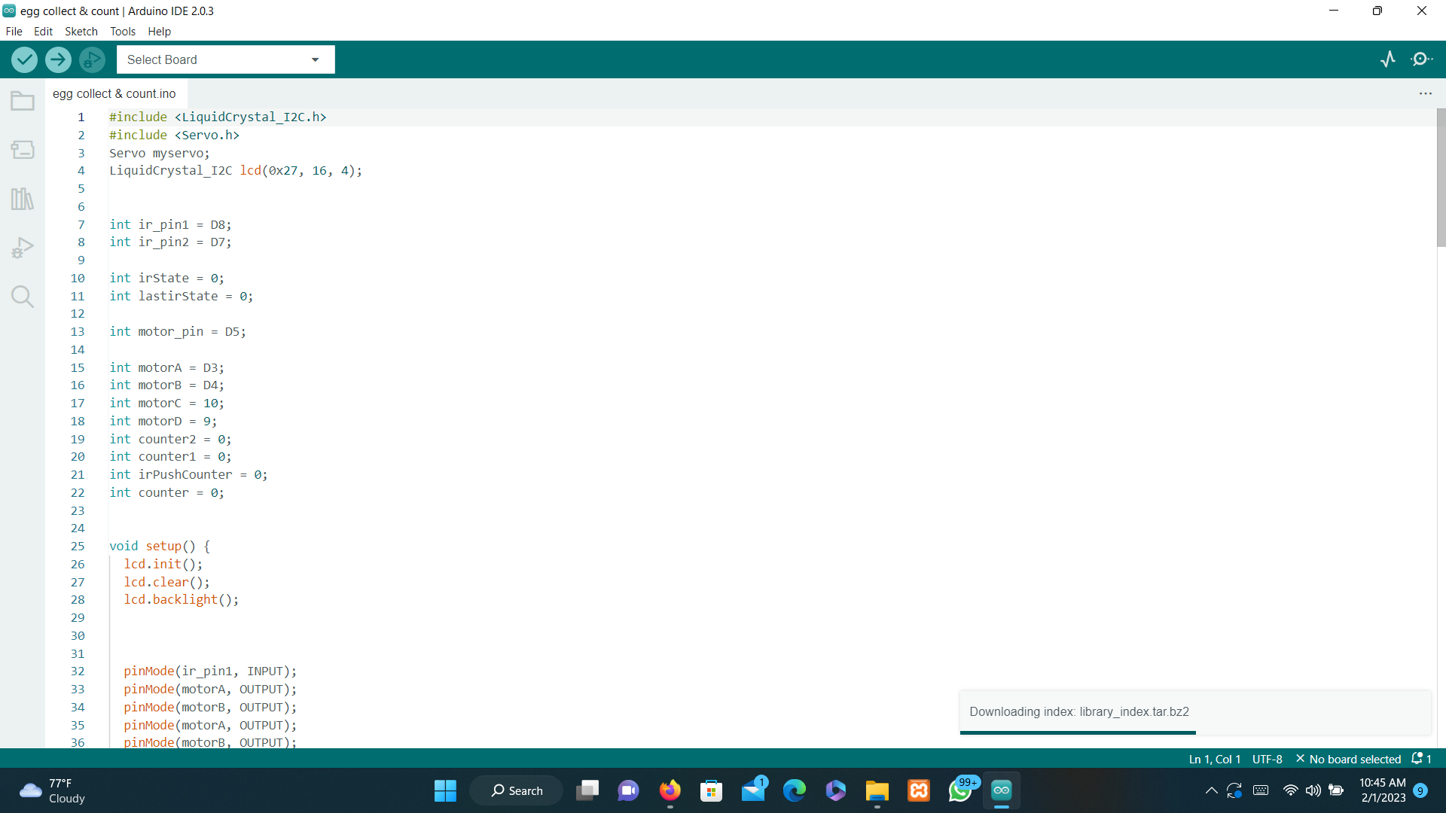
Completion of the Project
IT19958484 | AMSC Ananda
| Project Id: 22_23-J 35
13

Slide 43
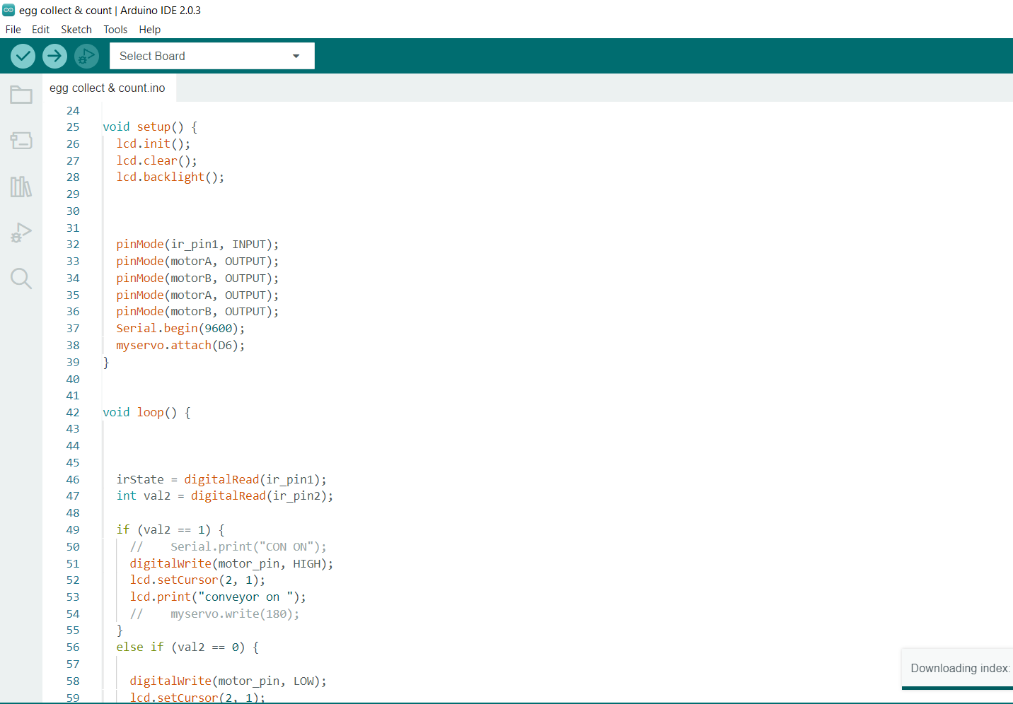
Completion of the Project
IT19958484 | AMSC Ananda
| Project Id: 22_23-J 35
13

Slide 44
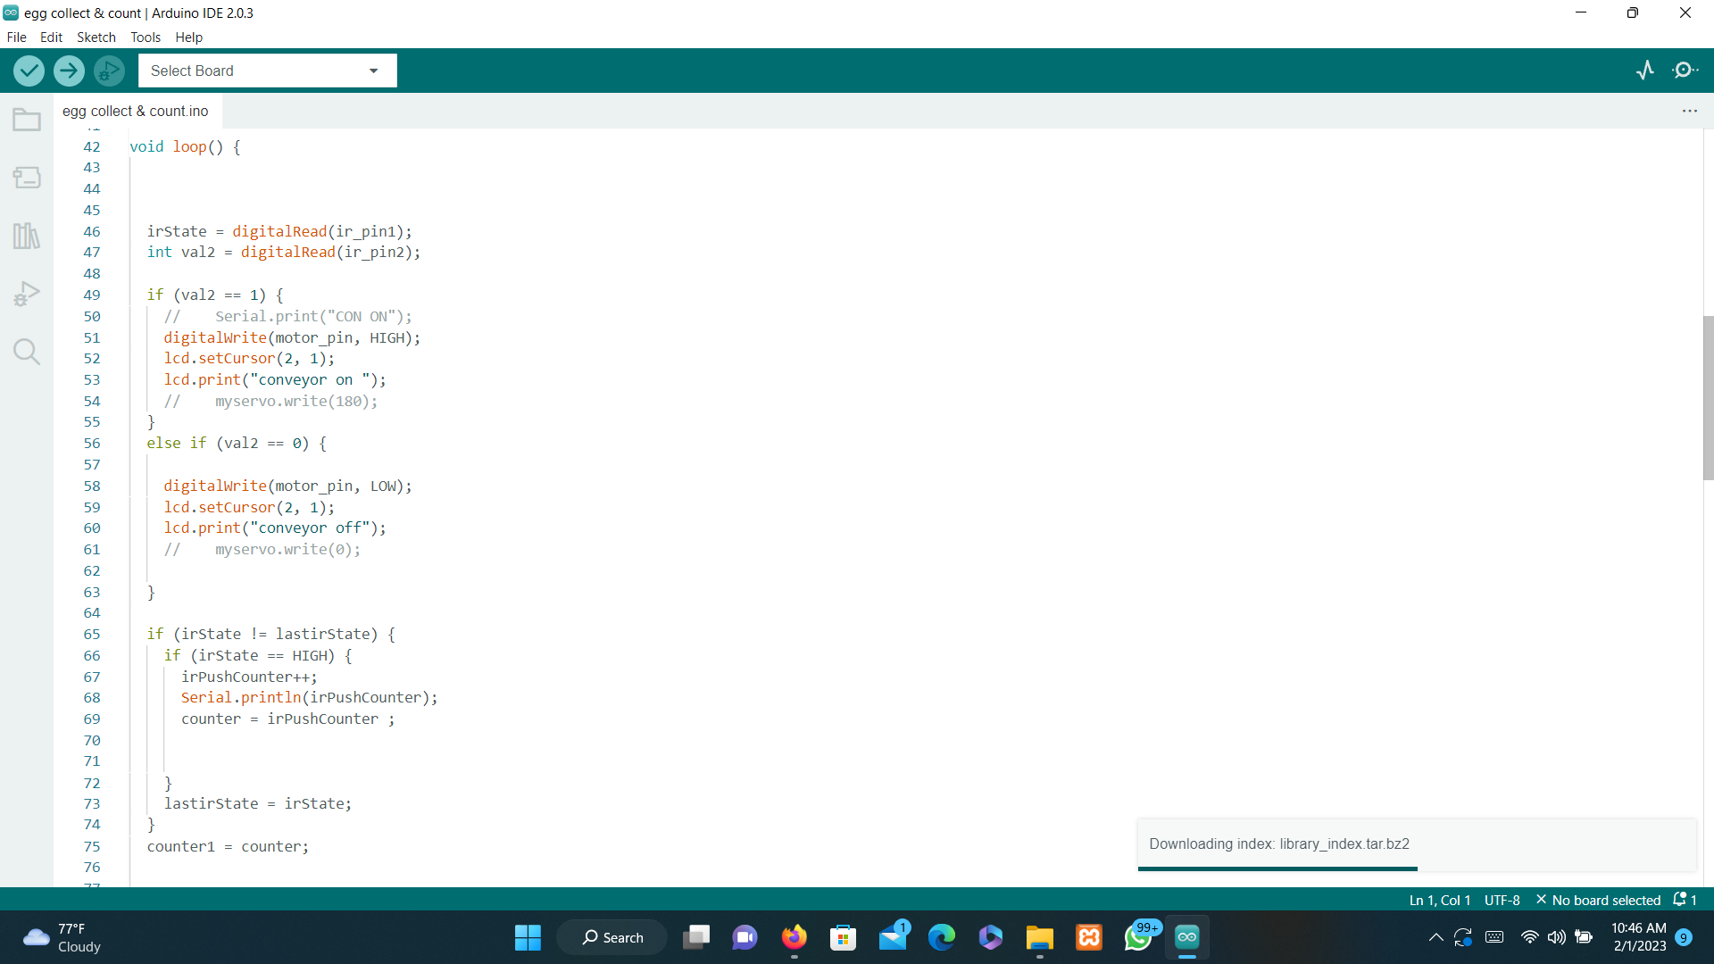
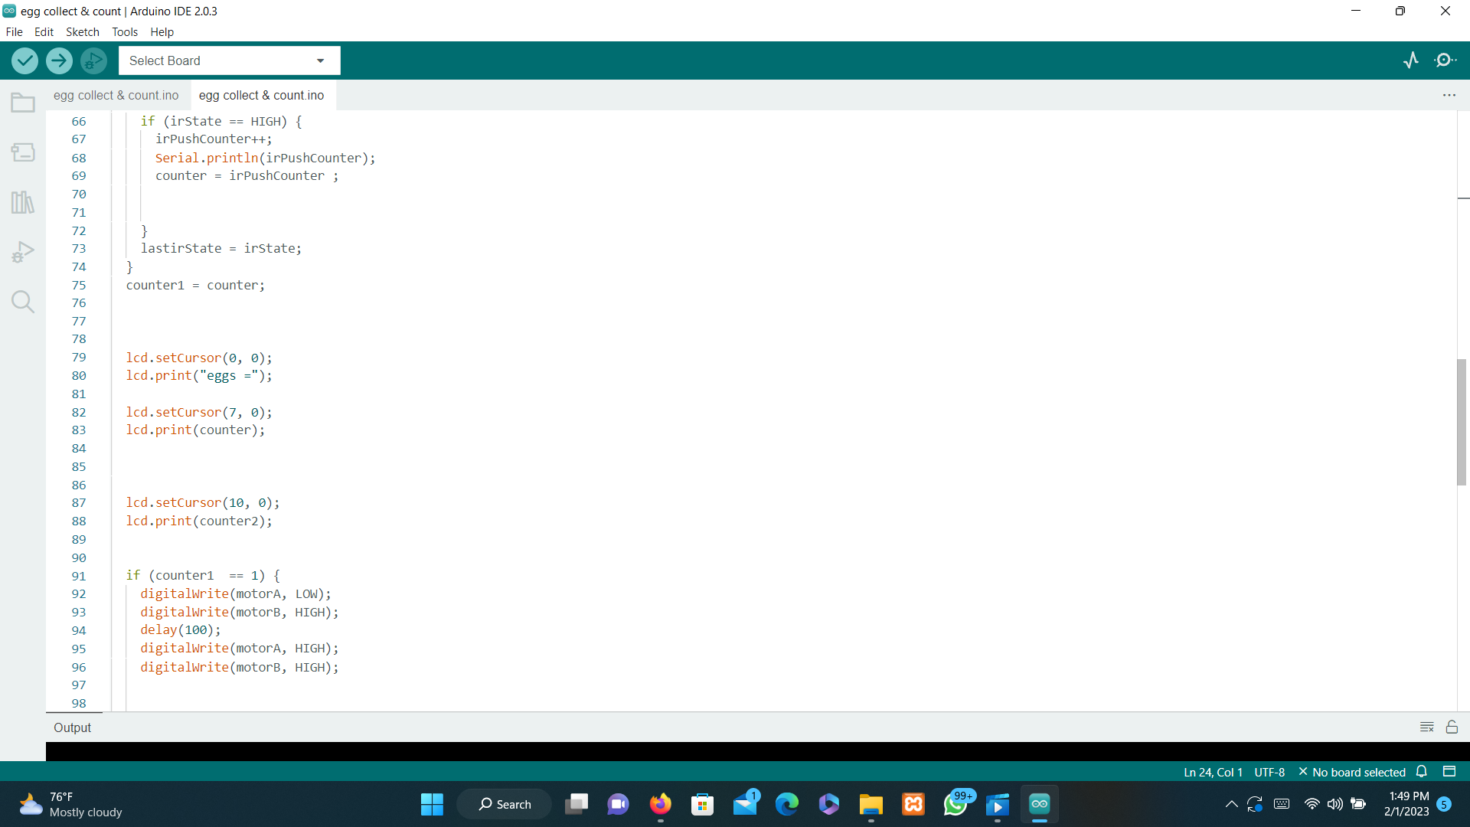
Completion of the Project
IT19958484 | AMSC Ananda
| Project Id: 22_23-J 35
14

Slide 45
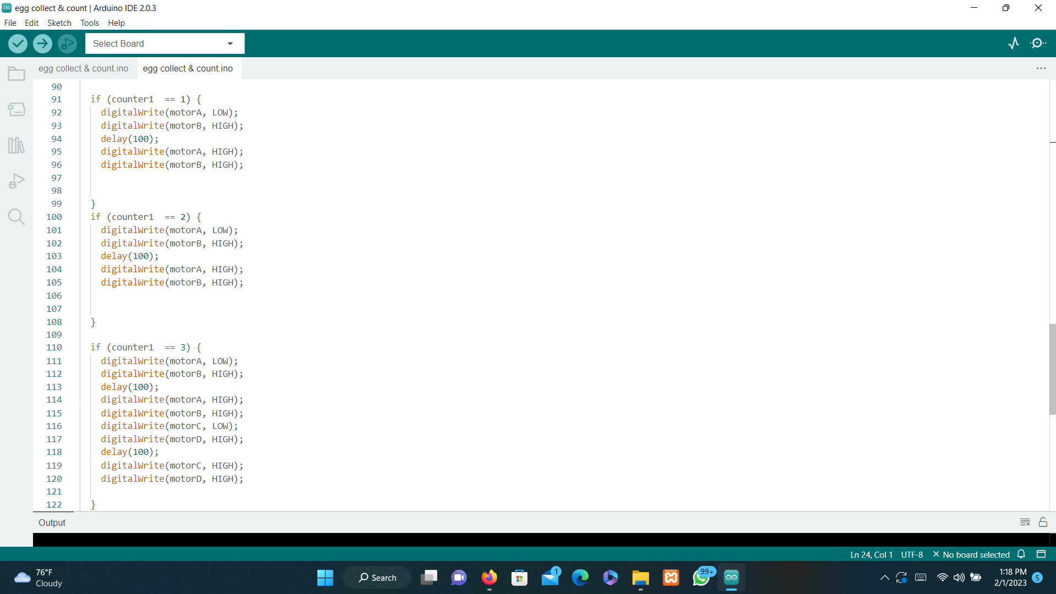
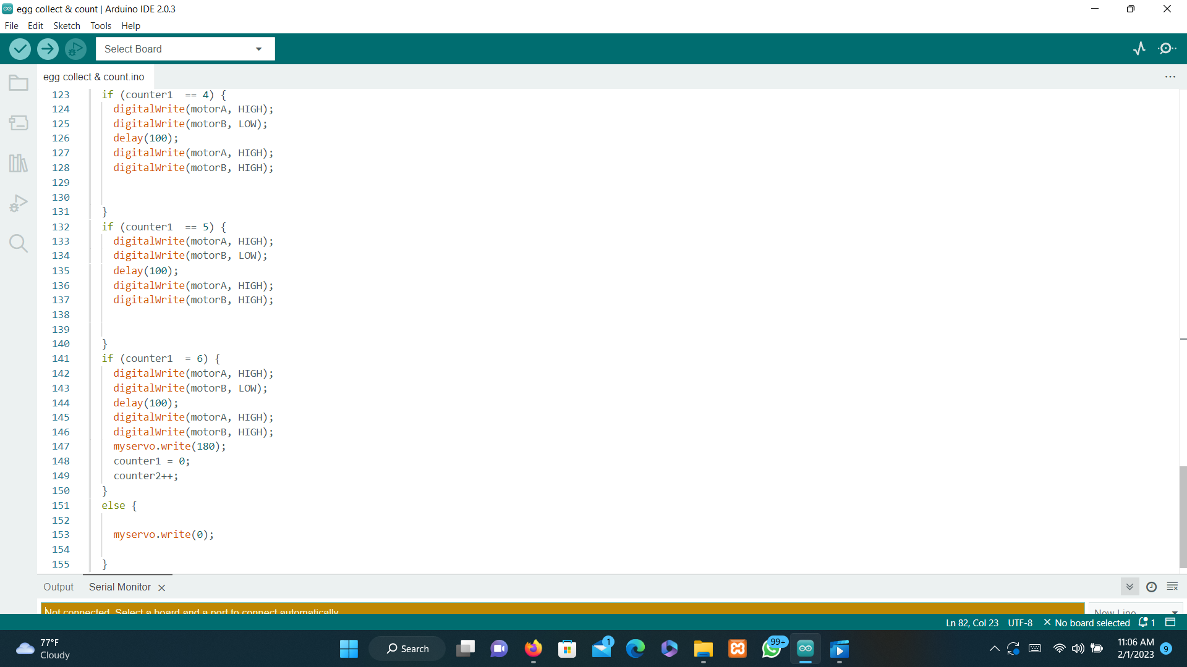
Completion of the Project
IT19958484 | AMSC Ananda
| Project Id: 22_23-J 35
15

Slide 46

Achivements
Implement a method to count the eggs and display Collecting appropriate data from various data sources .
Implement a method to place the eggs one by one to a egg tray
completed egg counting and collecting circuit
IT19958484 | AMSC Ananda
| Project Id: 22_23-J 35
17

Slide 47

What's to be done
A method to place the eggs on the conveyor belt one by one from the bucket that hens lay eggs
Make the conveyor belt only to carry a one egg to the egg counter
Display the total no of eggs on the mobile app.
IT19958484 | AMSC Ananda
| Project Id: 22_23-J 35
18

Slide 48
W.A.L.H.P.K.Perera IT19953434
SPECIALIZATION - INFORMATION TECHNOLOGY
IT19953434 |
W A L H P K Perera
| Project Id: 22_23-J 35
05

Slide 49
Novelty
"LowLightEfficientID: An Energy-Efficient and Occlusion-Resilient Person Detection and Recognition System for Low-Light Environments"
IT19953434 |
W A L H P K Perera
| Project Id: 22_23-J 35
06

Slide 50
Research Question
Difficulty opening the door when moving items to the chicken coop.
It is difficult for everyone working on the farm to use the same key.
When there is an emergency, it takes some time to open the door of the chicken coop, causing damage.
It is difficult for the farm owner to know the information about the workers entering the chicken coop.
IT19953434 |
W A L H P K Perera
| Project Id: 22_23-J 35
08

Slide 51
Main Objective
To determine smart door lock in a hybrid approach for a low cost.
Sub Objective
01
02
03
04
To detect that a person has come near the door of the chicken coop.
To turn on the camera.
To identify the person using image processing and video processing.
To notify the result through the mobile application.
IT19953434 |
W A L H P K Perera
| Project Id: 22_23-J 35
09

Slide 52

Research Gap
Features | Research(A) | Research(B) | Research(C) | Research(D) | Research(E) | Research(F) | Our Expected System
Identifying authorized persons using face recognition technology
Use in low light conditions.
Recognition from motion analysis.
Occlusion resilient person detection and image id creation.
Automatic door lock opening and closing using iot technology
Create an android application and notify the user through it.
07
IT19953434 |
W A L H P K Perera
| Project Id: 22_23-J 35

Slide 53
Methodology
Allowing only authorized persons to enter the farm.
Here, when the authorized person arrives at the door of the farm, the system should recognize the person.
But the camera should not work 24 hours a day and should open only when a person is close to the camera.
The entire image should be detected by image processing and the person should be identified and accessed using motion analysis.
10
IT19953434 |
W A L H P K Perera
| Project Id: 22_23-J 35

Slide 54
System Diagram
IT19953434 |
W A L H P K Perera
| Project Id: 22_23-J 35
11

Slide 55
Technologies, Tools and Algorithms
Algorithm: Logistic Regression
Model training: colab
Image Processing & IOT
Develop Mobile application:Fullter
Languages: python , Dart
12
IT19953434 |
W A L H P K Perera
| Project Id: 22_23-J 35

Slide 56
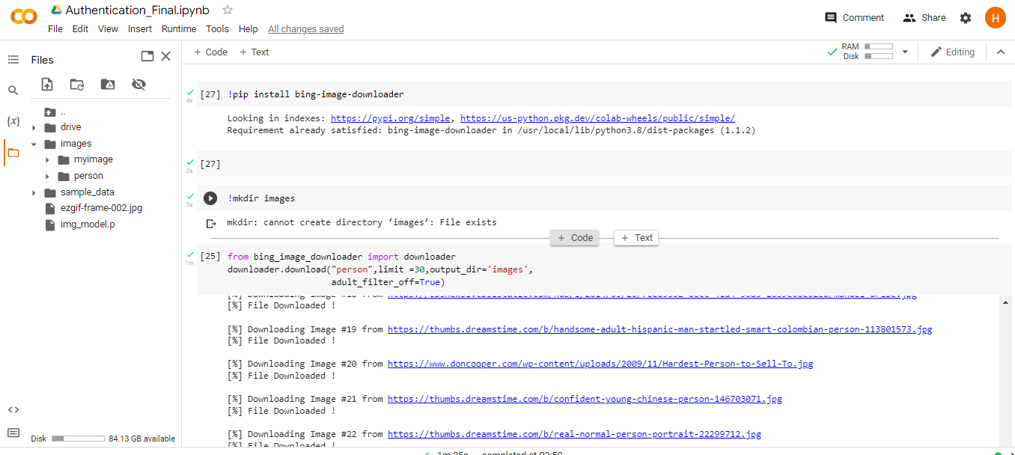
Completion of the Project
14
IT19953434 |
W A L H P K Perera
| Project Id: 22_23-J 35

Slide 57
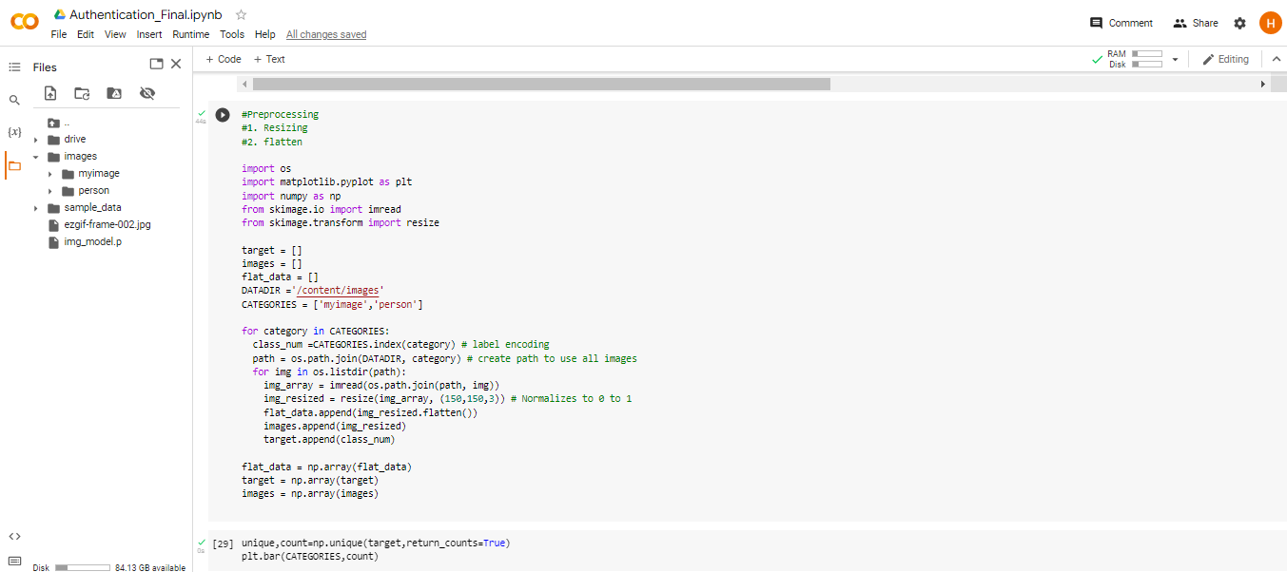
Completion of the Project
15
IT19953434 |
W A L H P K Perera
| Project Id: 22_23-J 35

Slide 58
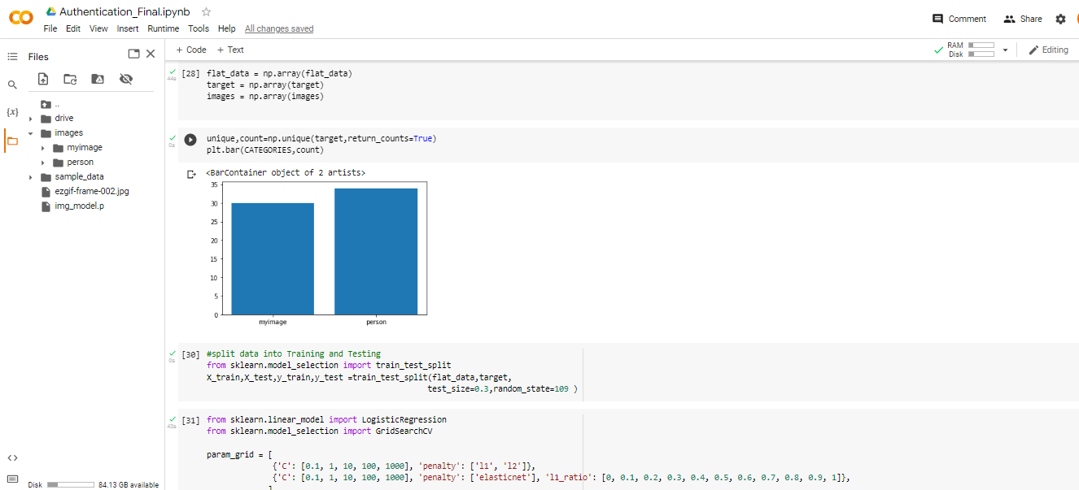
Completion of the Project
16
IT19953434 |
W A L H P K Perera
| Project Id: 22_23-J 35

Slide 59
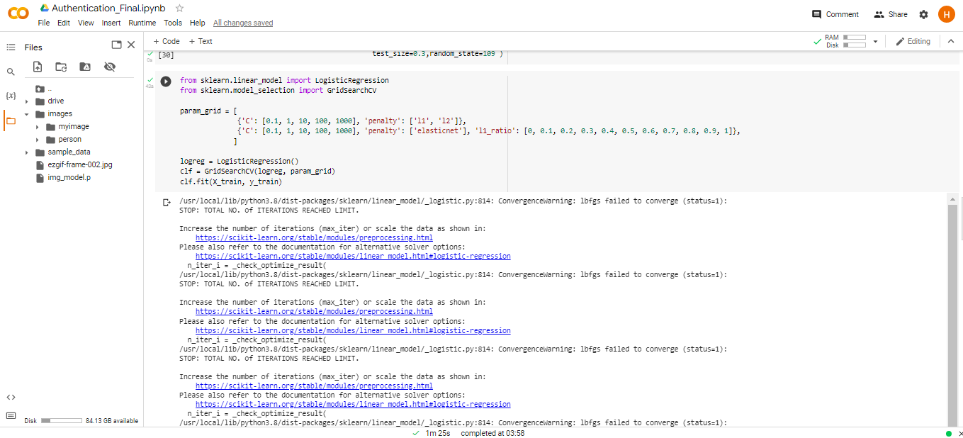
Completion of the Project
16
IT19953434 |
W A L H P K Perera
| Project Id: 22_23-J 35

Slide 60
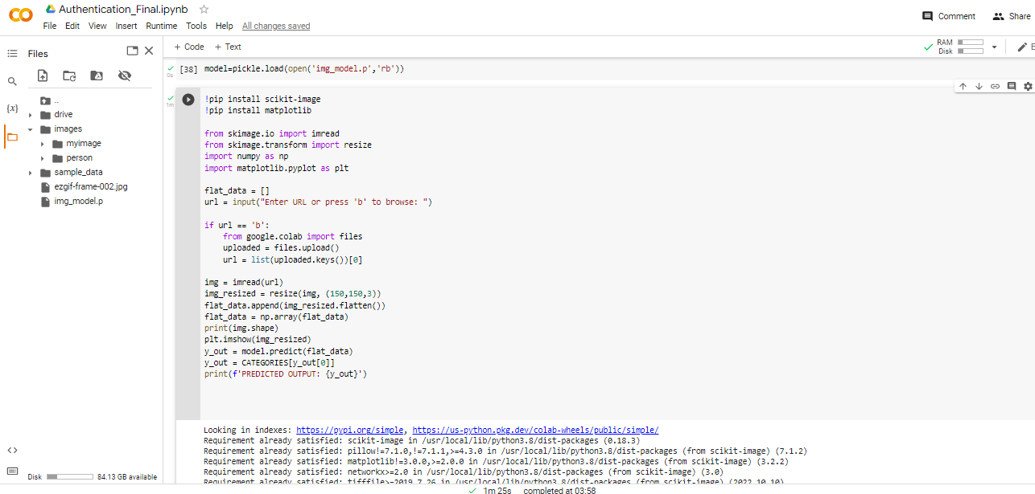
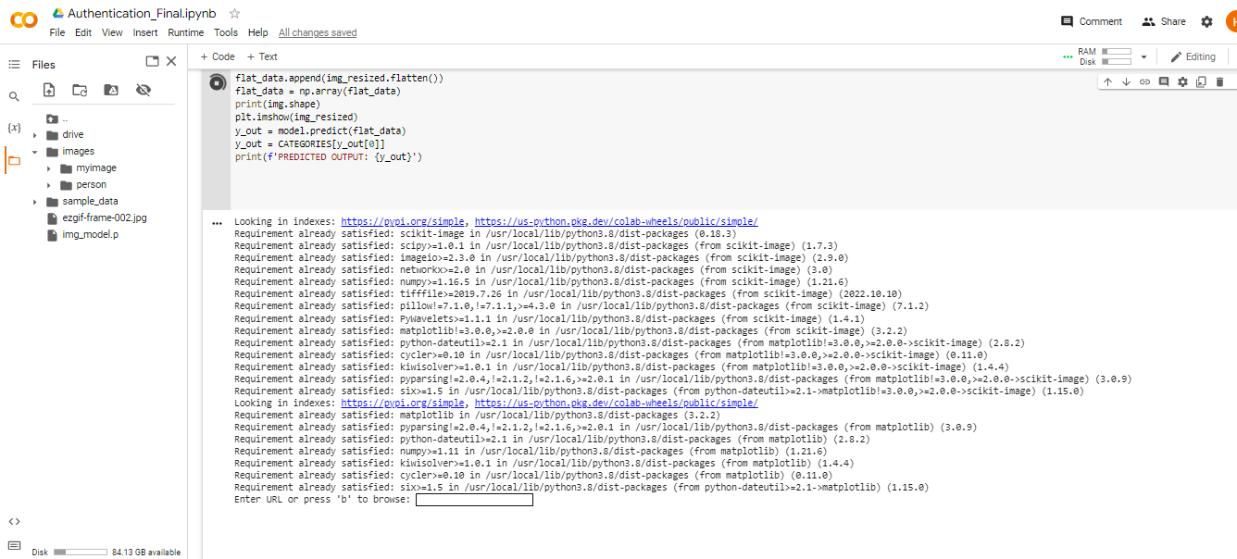
Completion of the Project
16
IT19953434 |
W A L H P K Perera
| Project Id: 22_23-J 35

Slide 61
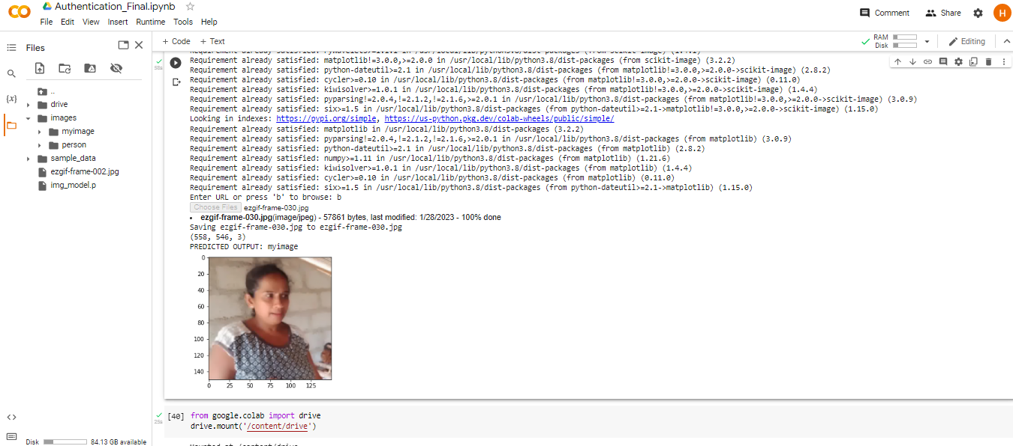
Completion of the Project
16
IT19953434 |
W A L H P K Perera
| Project Id: 22_23-J 35

Slide 62

Achievements
Train the model to identify farmers
Collected data set
Checking the accuracy of the model using sample data set
17
IT19953434 |
W A L H P K Perera
| Project Id: 22_23-J 35

Slide 63
What's to be done
Recognition from motion analysis.
Occlusion resilient person detection and image id creation.
Complete a user-friendly Mobile application.
18
IT19953434 |
W A L H P K Perera
| Project Id: 22_23-J 35

Slide 64


